Slide 1
Computer Vision
Oualid Missaoui

Slide 2
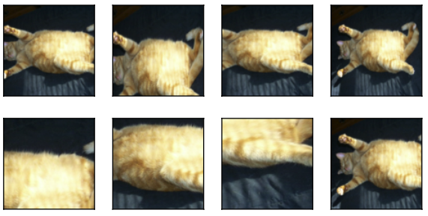
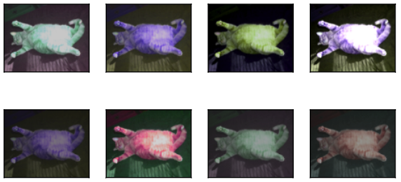
Image augmentation
Flipping and cropping
Changing colors
Combining multiple augmentation methods

Slide 3
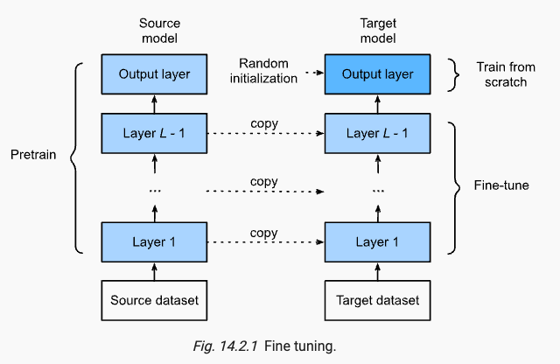
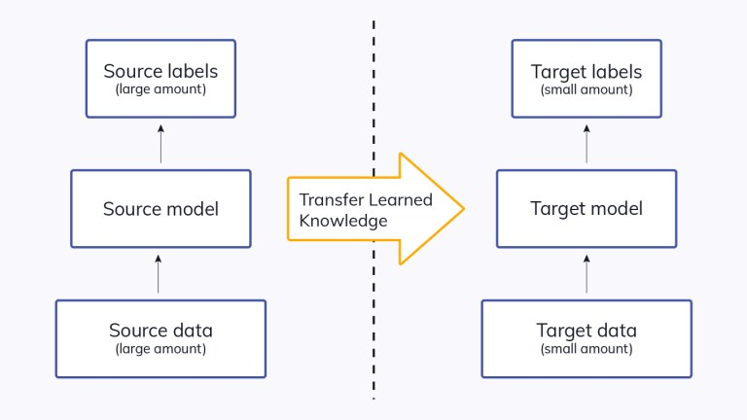
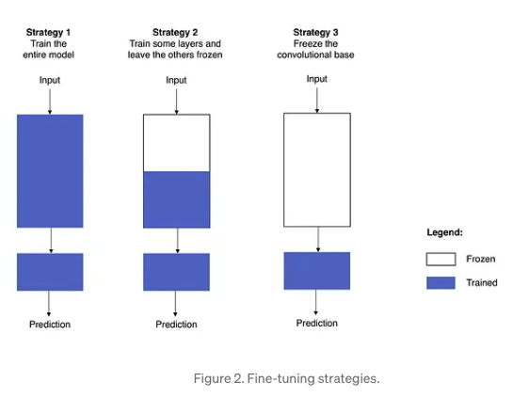
Fine Tuning/ Transfer Learning
source
source

Slide 4
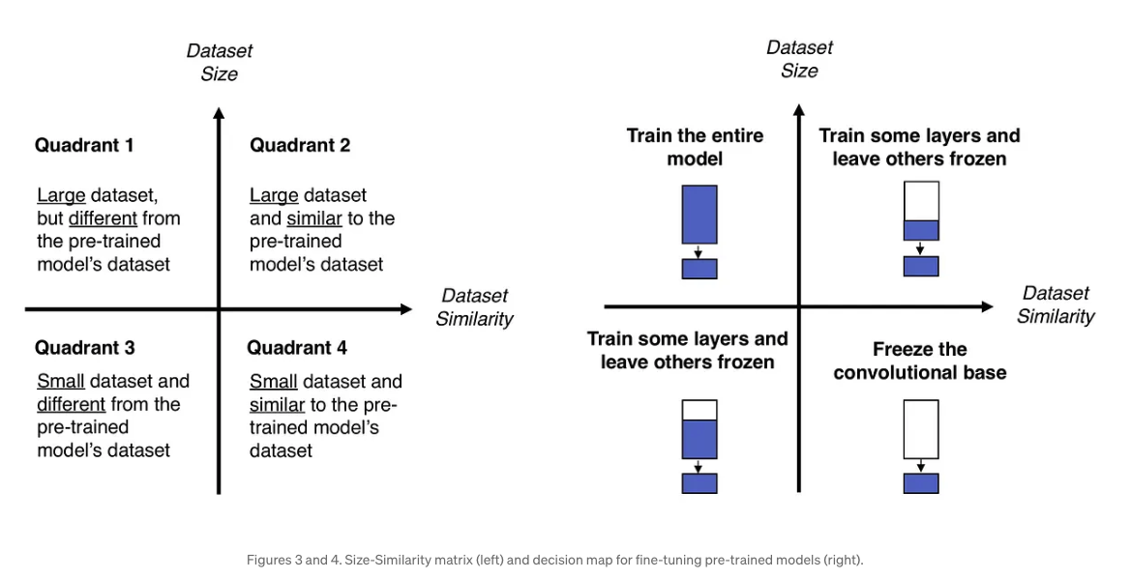
Transfer Learning
source

Slide 5
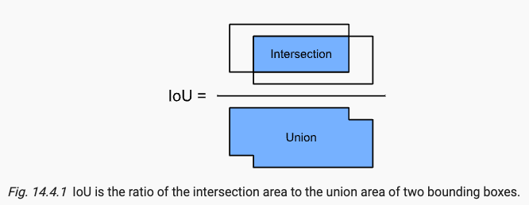
Object detection/recognition
Bounding boxes
Scale s (between 0 and 1)
Aspect ratio r (ratio of width to height)
Anchor Boxes :
Generated
Anchor box quality vs a ground truth bounding box

Slide 6
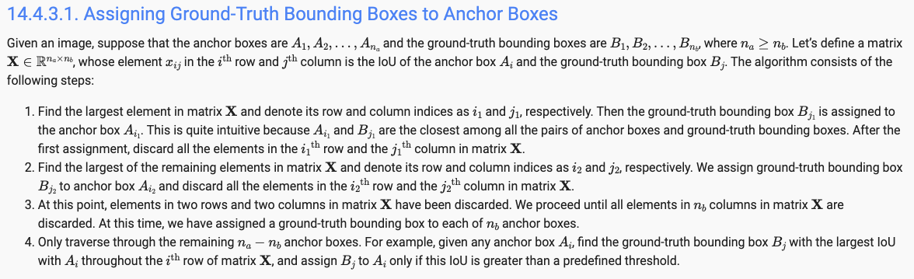
Object detection training data
Ground-truth bounding boxes :
Labels for locations
Classes of their surrounded objects
Anchor Boxes:
Generate
Compute offset to ground-truth bounding box
Assign class of the closest ground-truth bunding box class
An anchor box without assignment is labeled as a background

Slide 7
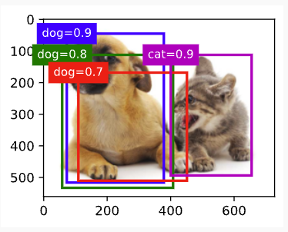
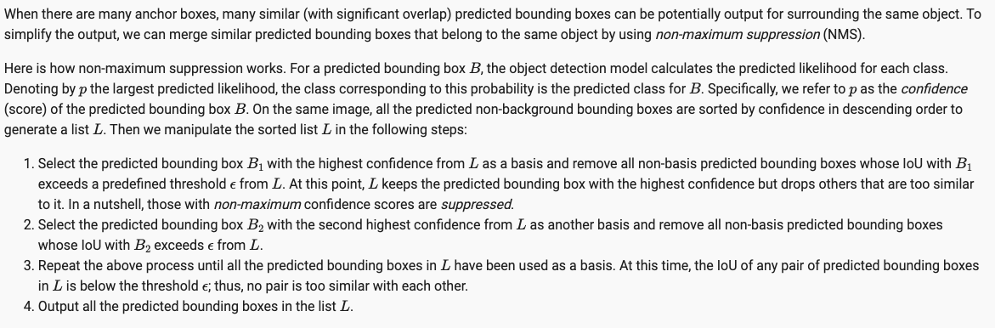
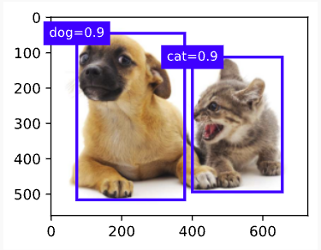
Object detection prediction
Predicting bounding boxes with non-maximum suppression

Slide 8
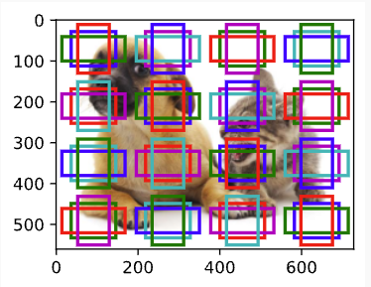
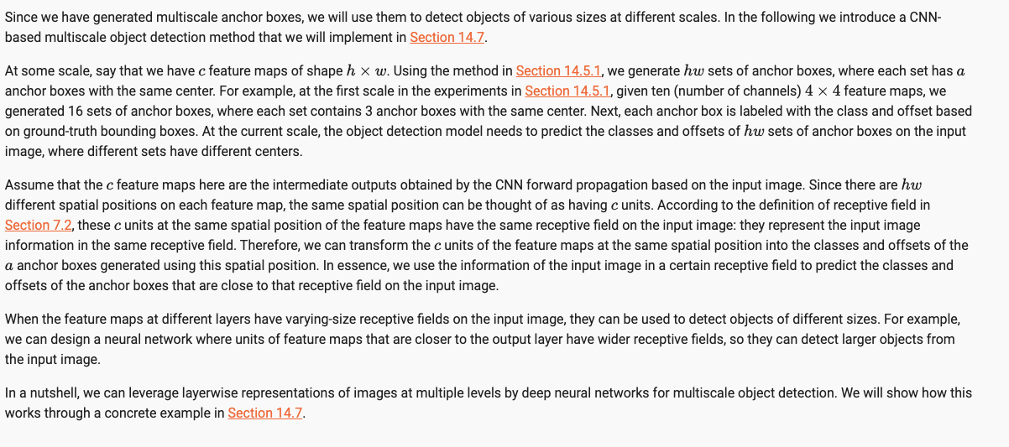
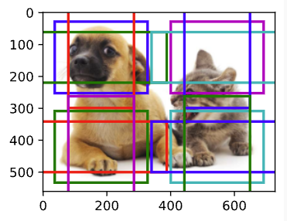
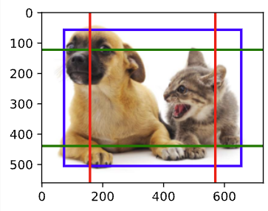
Multiscale object detection

Slide 9
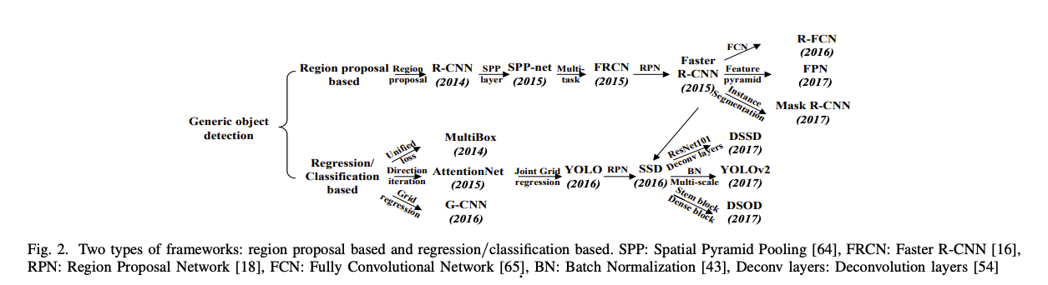
Taxonomy of deep learning based object detection approaches
Zhong-Qiu Zhao et al, Object Detection with Deep Learning: A review, 2019

Slide 10
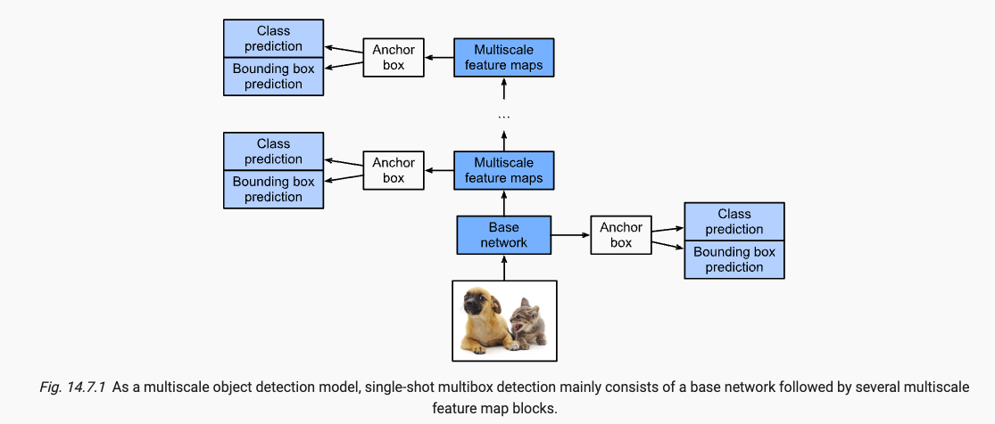
Single Shot Multibox Detection (SSD)
Layers:
Prediction:
Class layer
Bounding Box layer
Down-sampling block for multi-scale detection
Base Network block (e.g. VGG)
Loss:
Classes of anchor boxes
Offsets of positive (non-background) anchor boxes

Slide 11
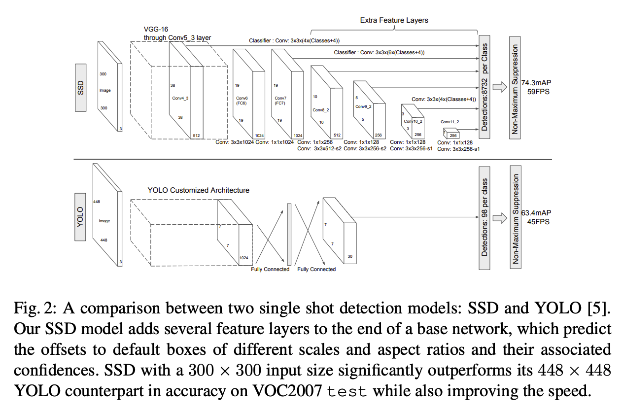
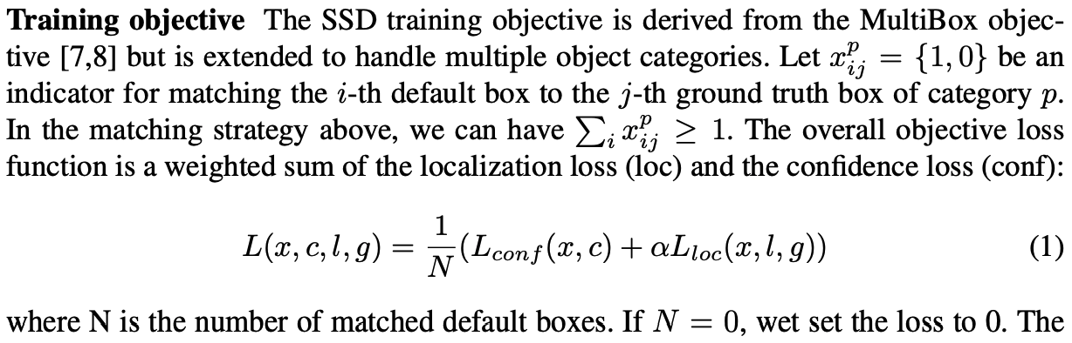
Single Shot Multibox Detection (SSD)
Wei Liu et al, SSD: Single Shot MultiBox Detector, 2016

Slide 12
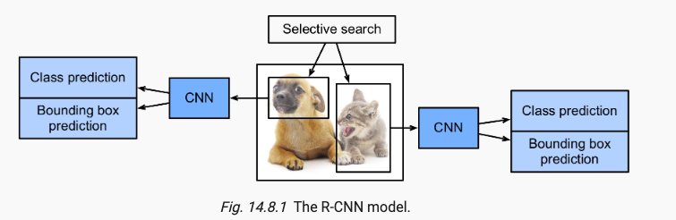
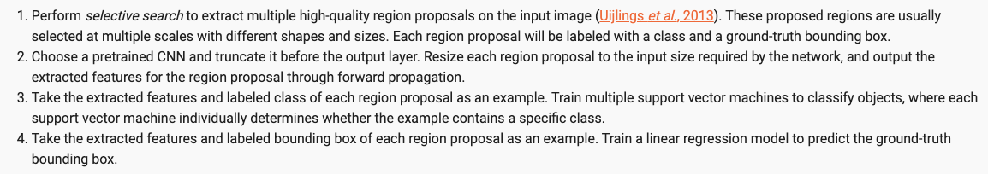
Region-Based CNNs (R-CNNs)

Slide 13
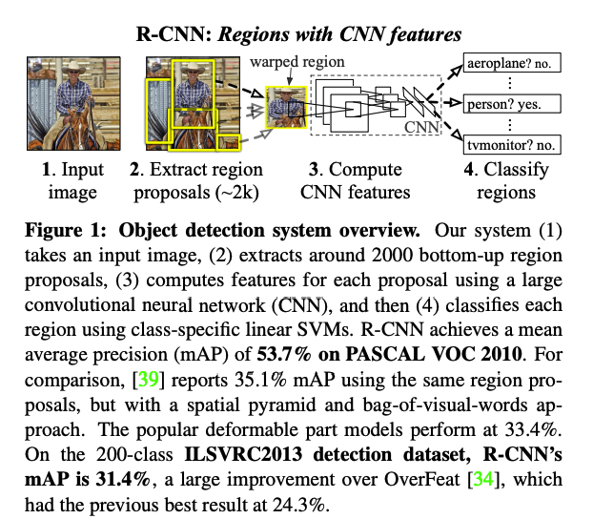
Region-Based CNNs (R-CNNs)
Ross Girshick et al, Rich feature hierarchies for accurate object detection and semantic segmentation, 2014

Slide 14
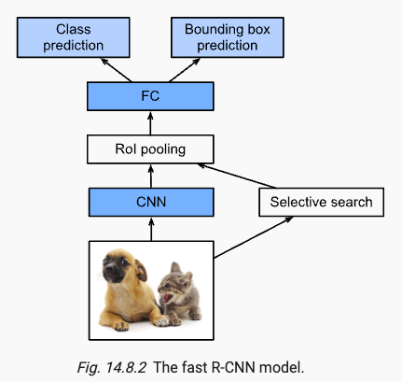
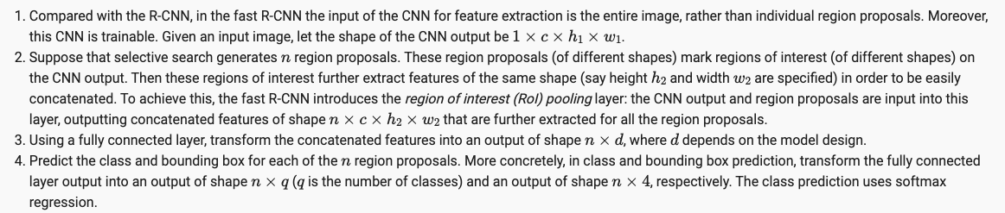
Fast RCNN

Slide 15
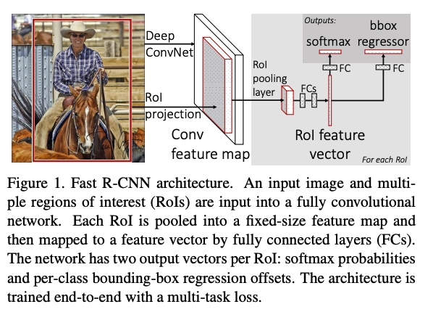
Fast R-CNN
Ross Girshick, Fast R-CNN, 2015

Slide 16
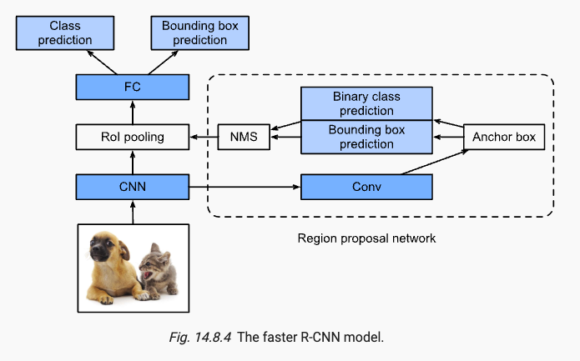
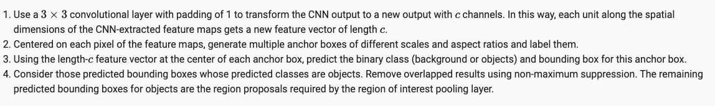
Faster RCNN

Slide 17
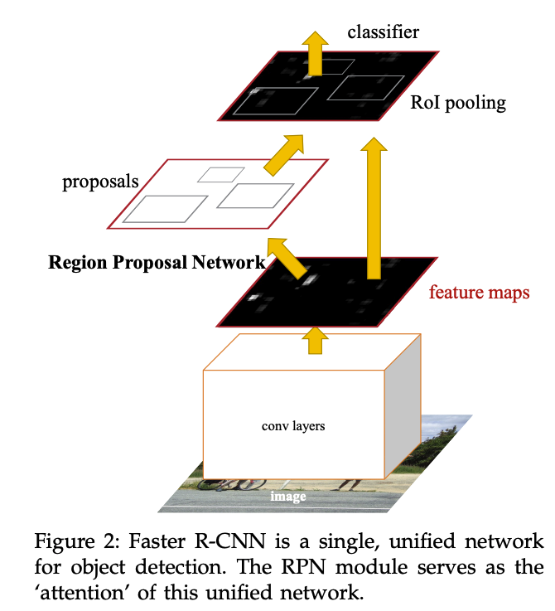
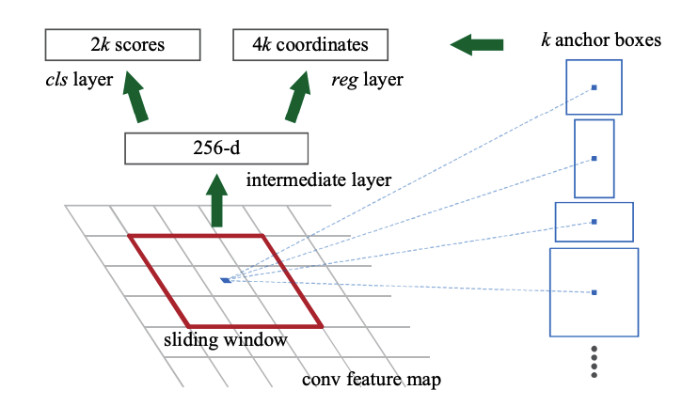
Faster R-CNN
Ren et al, Faster R-CNN: Towards Real-Time Object Detection with Region Proposal Networks, 2016

Slide 18
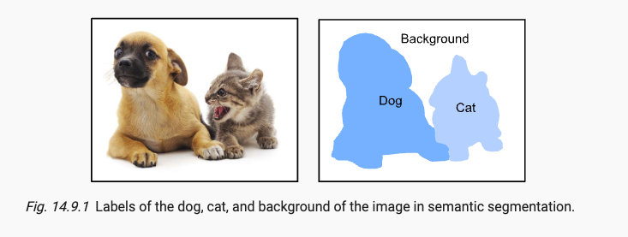
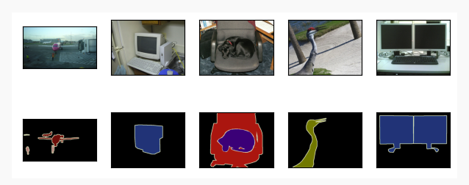
Semantic Segmentation

Slide 19
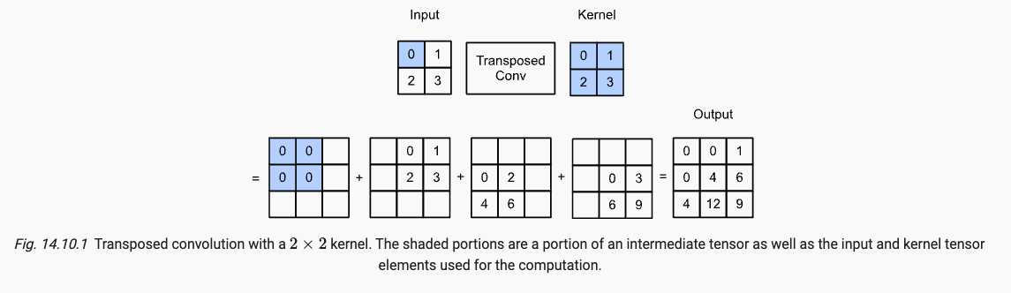
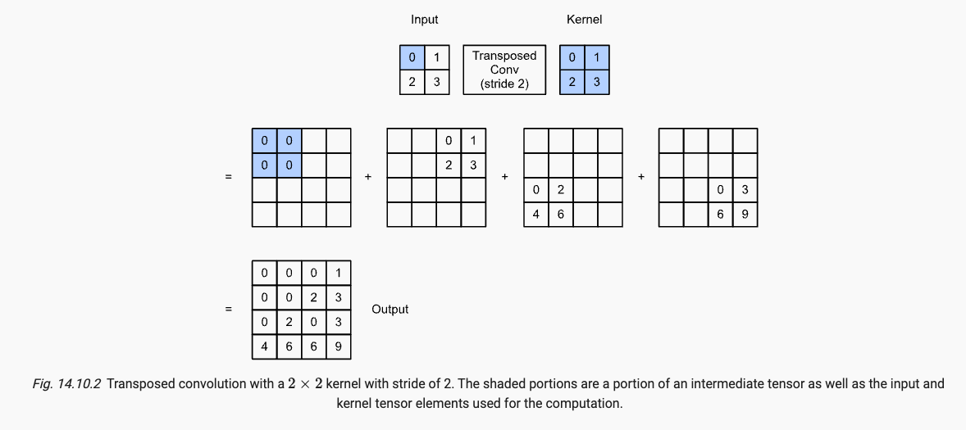
Transposed convolution
For semantic segmentation that classifiers at pixel-level, it will be convenient if the spatial dimensions of the input and output are the same
Transposed convolution (fractionally-strided convolution)

Slide 20
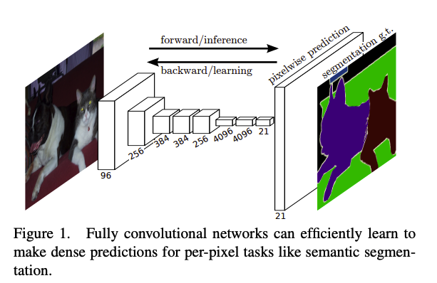
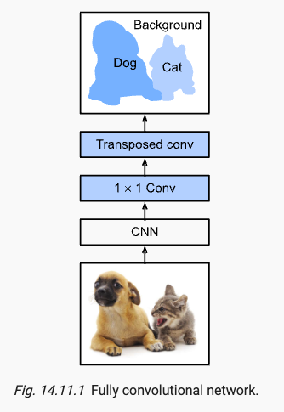
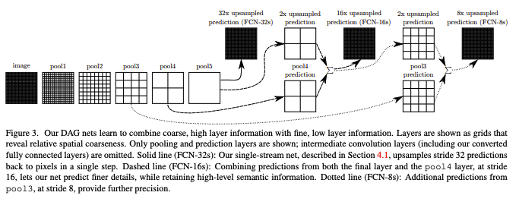
Fully convolutional Networks for semantic segmentation
Jonathan Long et al, Fully Convolutional Networks for Semantic Segmentation , 2015

Slide 21
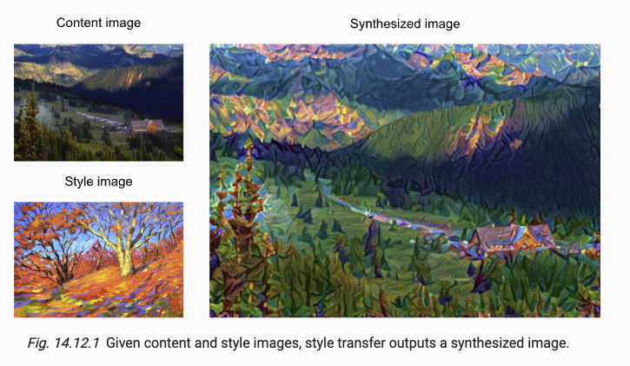
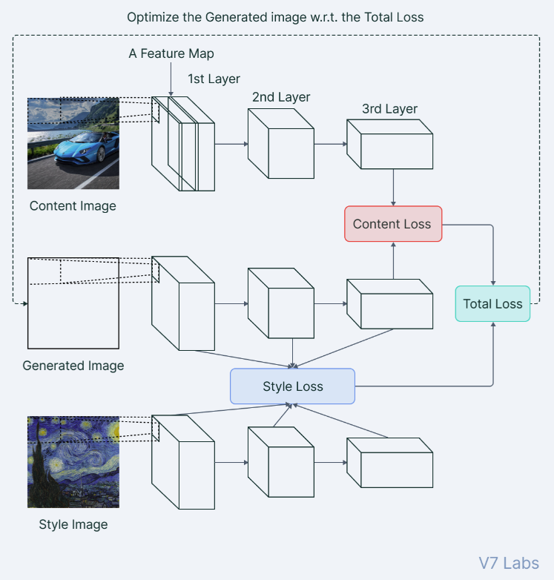
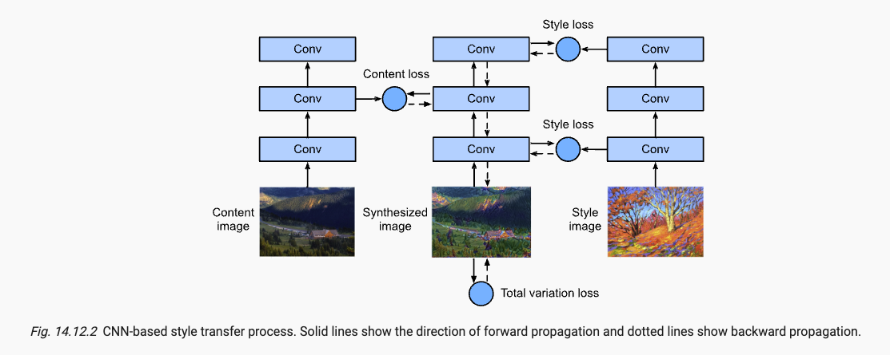
Neural Style Transfer
Loss function components:
content loss: synthesized and content close
Style loss: synthesized and style close
Total variation: reduce noise in the synthesized image
source

Slide 22
References
Blog posts
Transfer Learning Guide: A practical Tutorial with Examples for Images and Text in Keras.
How to Train an Object Detection Model with Keras
Transfer learning from pre-trained models
Papers
Ross Girshick et al, Rich feature hierarchies for accurate object detection and semantic segmentation, 2014
Ross Girshick, Fast R-CNN, 2015
Jonathan Long et al, Fully Convolutional Networks for Semantic Segmentation , 2015
Ren et al, Faster R-CNN: Towards Real-Time Object Detection with Region Proposal Networks, 2016
Wei Liu et al, SSD: Single Shot MultiBox Detector, 2016
Zhong-Qiu Zhao et al, Object Detection with Deep Learning: A review, 2019
Fuzhen Zhuang, et al, A Comprehensive Survey on Transfer Learning, 2020

